Slide 1
Advanced pharmaceutical analysis mass spectrometry 5 stage lect.3

Slide 2
Alkenes Acyclic Alkenes • Relatively strong M⁺ ion • A series of peaks: M-15, M-29,M-43,M-57, etc • Strong peak from fragmentation to form a resonance stabilized allylic cation(m/z = 41 in terminal double bond. * homolytic cleavage to give allylic carbocation

Slide 3
- An important fragment in the mass spectra of terminal alkene, the Allyl carbocation ,occurs at an m/e of 42. it is due to cleavage of the type:

Slide 4
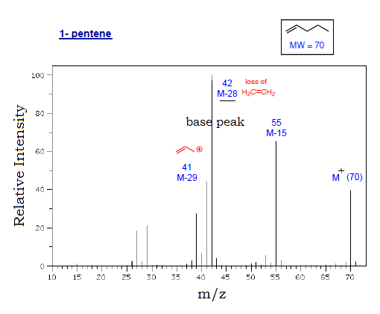

Slide 5
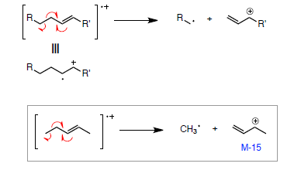
fragmentation processes • McLafferty rearrangement • allylic α-cleavage

Slide 6
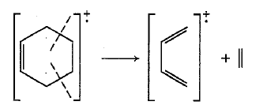
Cyclic Alkenes • Double bonds favor allylic cleavage to give the resonance stabilized allylic carbocation • Cyclohexenes can undergo retro-Diels-Alder reactions; may be significant • Side chains are easily fragmented

Slide 7
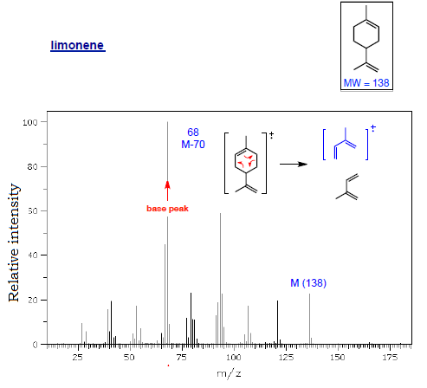

Slide 8
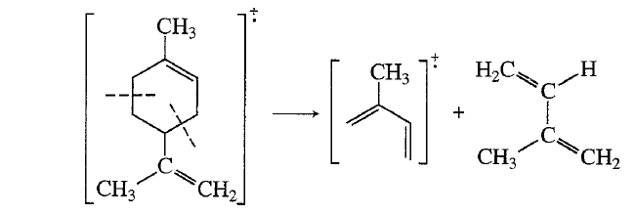

Slide 9
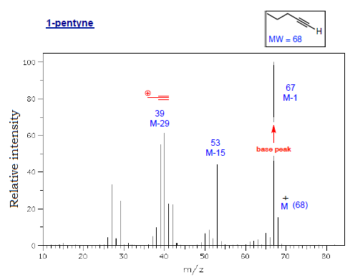
Alkynes • Strong M-1 peak is observed in ter. alkynes • Strong peak from fragmentation to give resonance stabilized propargyl cation(m/z = 39 [important]in terminal alkynes)

Slide 11
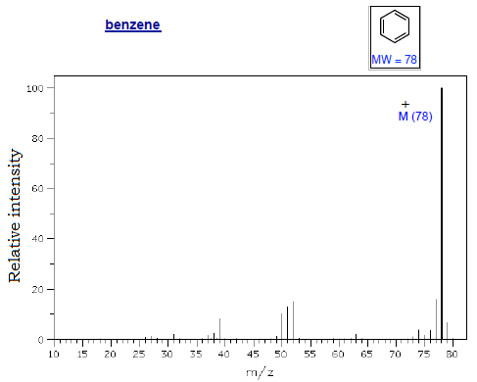
Aromatic Hydrocarbons • Strong M⁺ ion • Strong M-1 * Methyl benzene= give benzyl cation= tropylium ion • Substituted benzenes can undergo McLafferty r.r. (substitutent = propyl or larger)

Slide 12
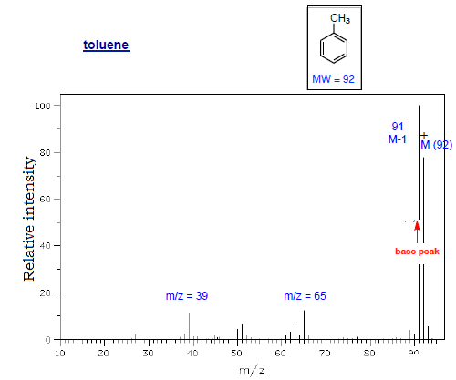

Slide 13
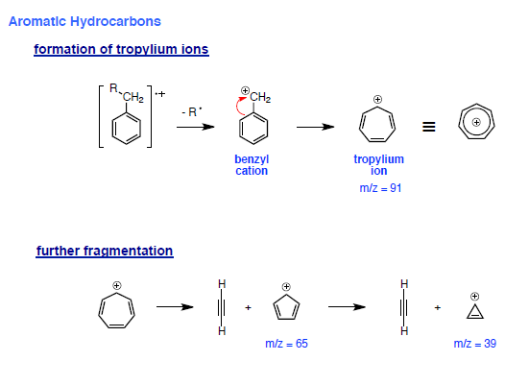

Slide 14
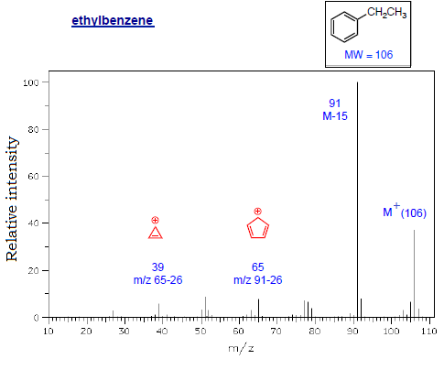

Slide 15
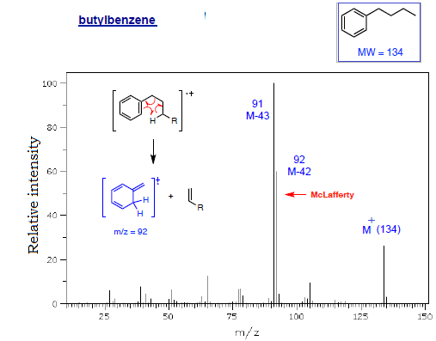

Slide 17
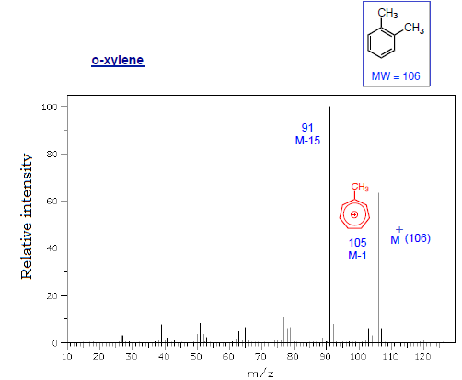

Slide 18
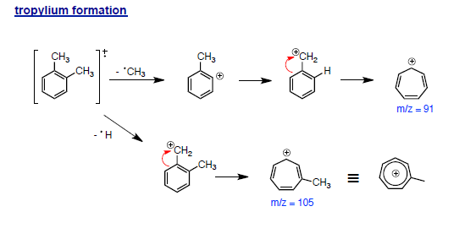

Slide 19
Cpds with Heteroatoms molecules containing O,N, halogens or other heteroatoms often undergo α-cleavage( adjacent to heteroatom) - Driving force is resonance stabilized cations Alcohols Acyclic Alcohols • Weak M⁺ peak; may be absent • Dehydration (M-18), sometimes with loss of CH2=CH2 • α-Cleavage of an alkyl radical (1° alcohols show m/z = 31) Largest substituent lost first • Loss of H radical adjacent to OH (M-1) may occur; usually minor

Slide 20
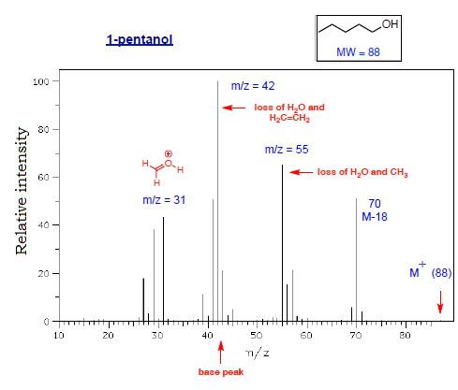

Slide 21
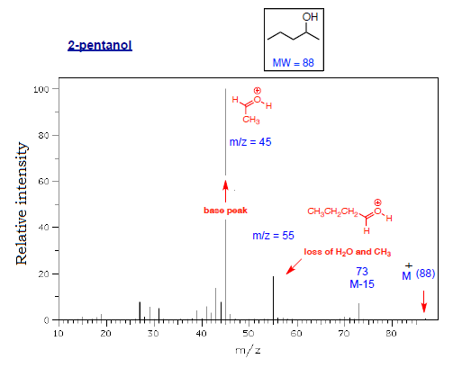

Slide 23
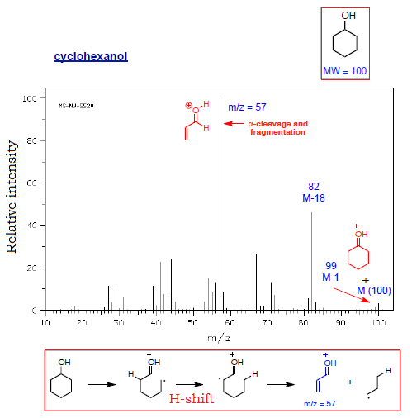
• α-cleavage of ring, with subsequent fragmentation to give protonated acrolein

Slide 24
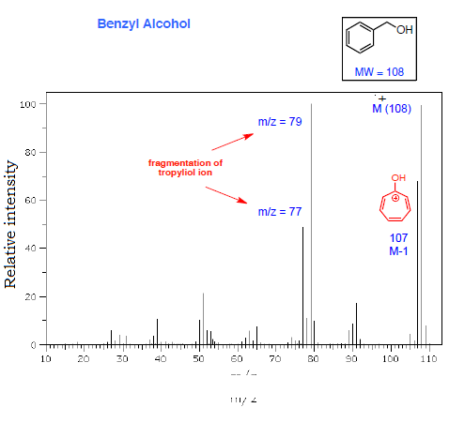
Benzyl Alcohols • Strong M⁺ peak • formation of tropyliol ions; then fragmentation to C6H5 +

Slide 25
fragmentation of tropyliol dehydration

Slide 26
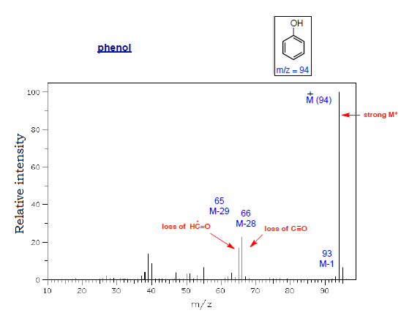
Phenols • Strong M⁺ peak • May show strong [M-1] • Loss of C≡O (M-28) and net loss of formyl radical (M-29)

Slide 28
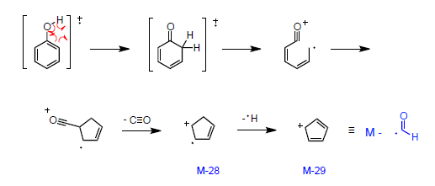
Loss of C≡O and H-C=O radical (net)

Slide 29
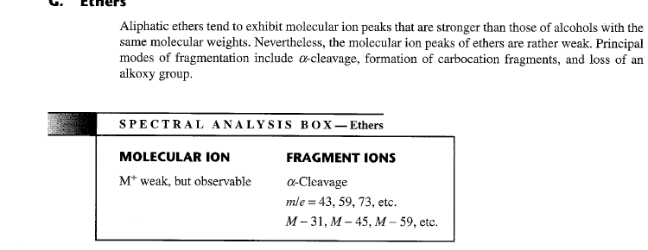
ethers

